Slide 1
TOGAF for
Yesterday, Today and Tomorrow
Paul van der Merwe
Head of Enterprise Architecture
Standard Bank Group

Slide 2


Slide 3
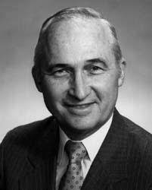

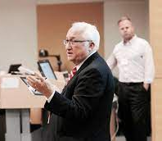
Enterprise Architecture
What is your strategy for addressing:
Orders of magnitude increases in complexity, and
orders of magnitude increase in the rate of change?
Seven thousand years of history would suggest the only known strategy for addressing complexity and change is ARCHITECTURE.
John Zachman

Slide 4
Architecture Domains
The National Institute of Standards and Technology (NIST), 1988 Information Management Directions: The Integration Challenge. Special Publication 500-167
The TOGAF® Standard, Version 9.2
© 2005-2018 The Open Group, All Rights Reserved

Slide 5
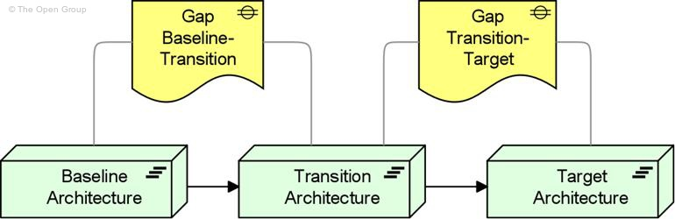
Time-based Partitions
ArchiMate® 2.1 Specification
Copyright © 2012-2013 The Open Group
Steven H. Spewak with Steven C. Hill, 1995. Enterprise Architecture Planning: Developing a Blueprint for Data, Applications, and Technology. John Wiley & Sons, New York City.

Slide 6
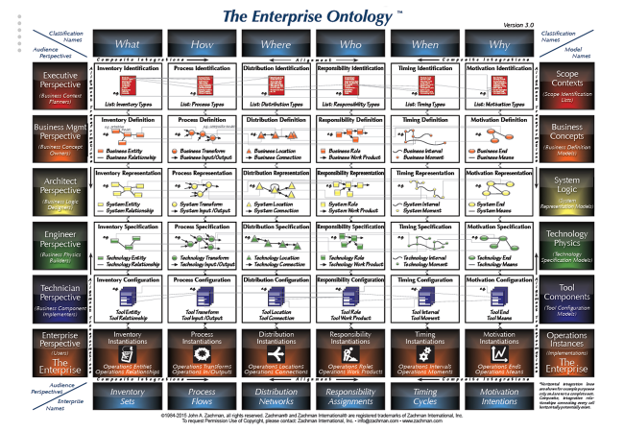
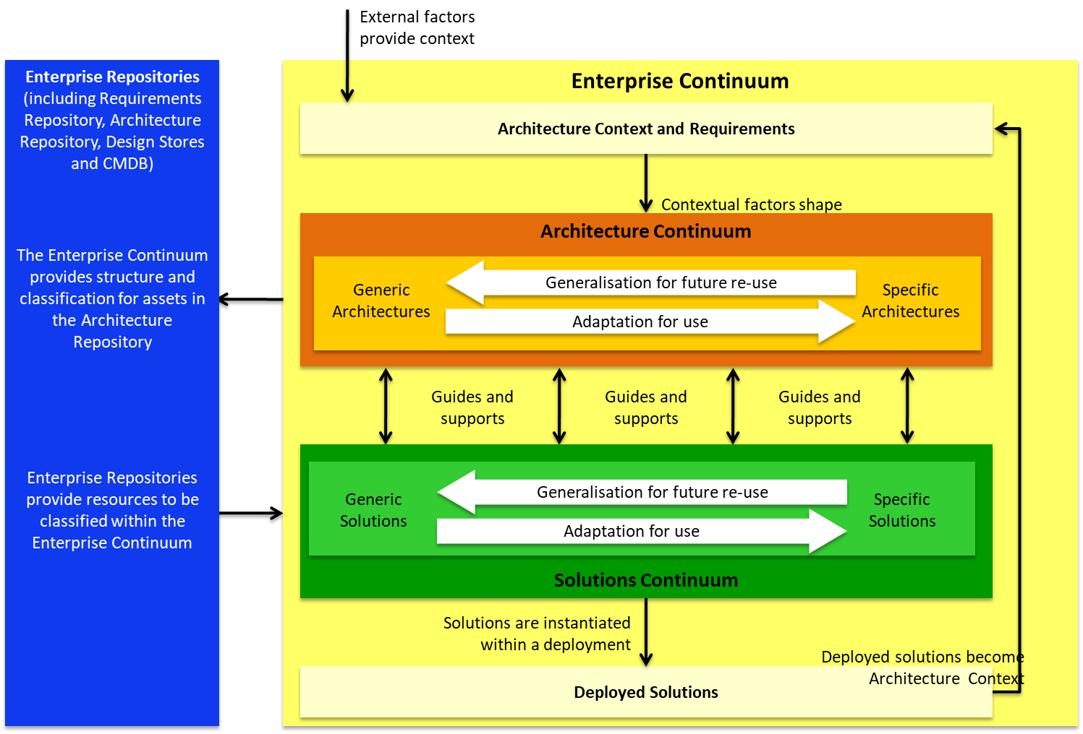
Enterprise Continuum
The TOGAF® Standard, Version 9.2
© 2005-2018 The Open Group, All Rights Reserved

Slide 7
Architecture Landscape
The TOGAF® Standard, Version 9.2
© 2005-2018 The Open Group, All Rights Reserved

Slide 8

Yesterday

Slide 9
TOGAF 8
TOGAF was developed by members of The Open Group, working within the Architecture Forum. The original development of TOGAF Version 1 in 1995 was based on the Technical Architecture Framework for Information Management (TAFIM), developed by the US Department of Defense (DoD). The DoD gave The Open Group explicit permission and encouragement to create TOGAF by building on the TAFIM, which itself was the result of many years of development effort and many millions of dollars of US Government investment.
Starting from this sound foundation, the members of The Open Group Architecture Forum have developed successive versions of TOGAF each year and published each one on The Open Group public web site.
In December 2001 TOGAF 7, the "Technical Edition", was published. TOGAF 8 ("Enterprise Edition") was first published in December 2002 and republished in updated form as TOGAF 8.1 in December 2003.
TOGAF (The Open Group Architecture Framework) Version 8.1 "Enterprise Edition“
©2003, The Open Group

Slide 10
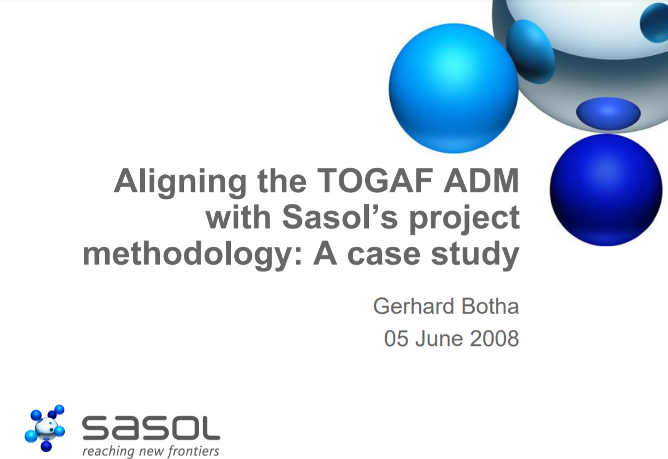
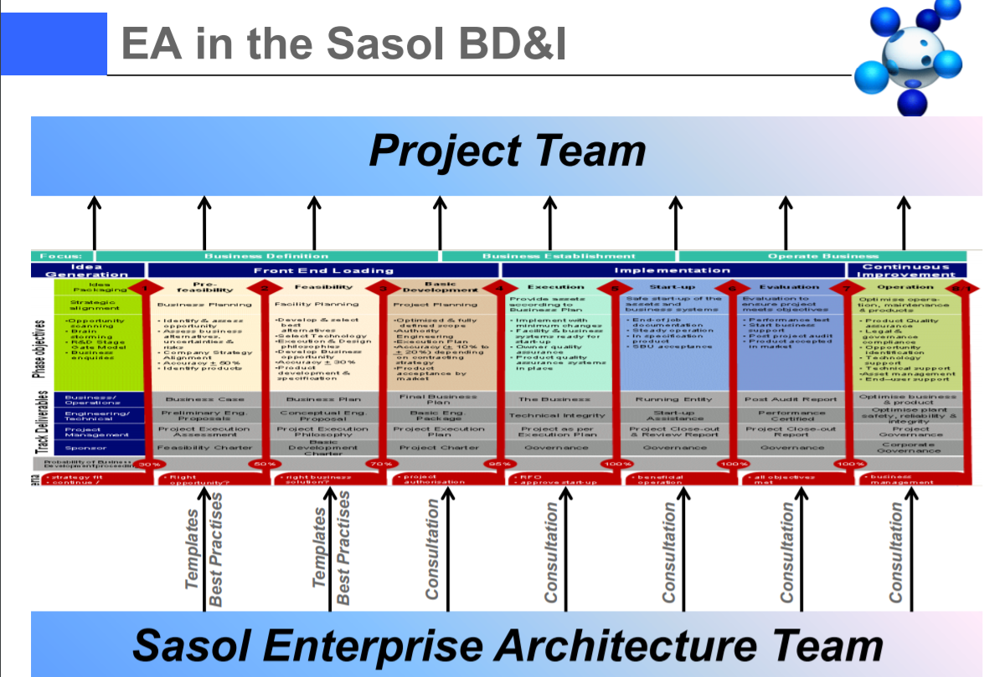
TOGAF Adoption

Slide 11
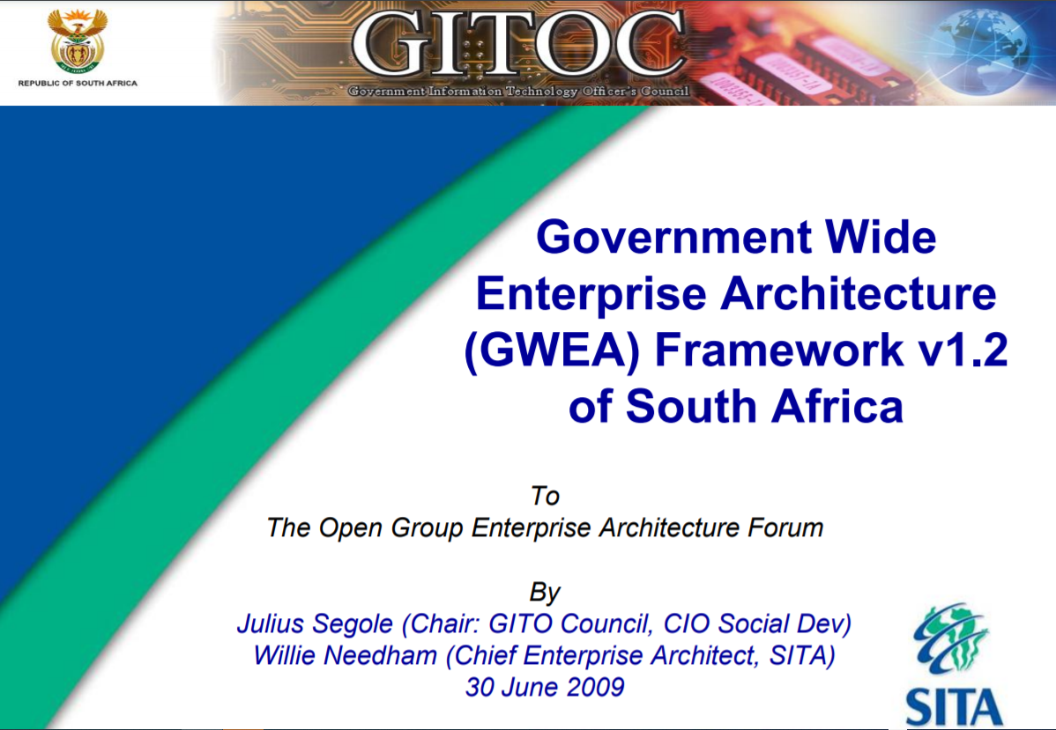
Government-wide EA Framework

Slide 12
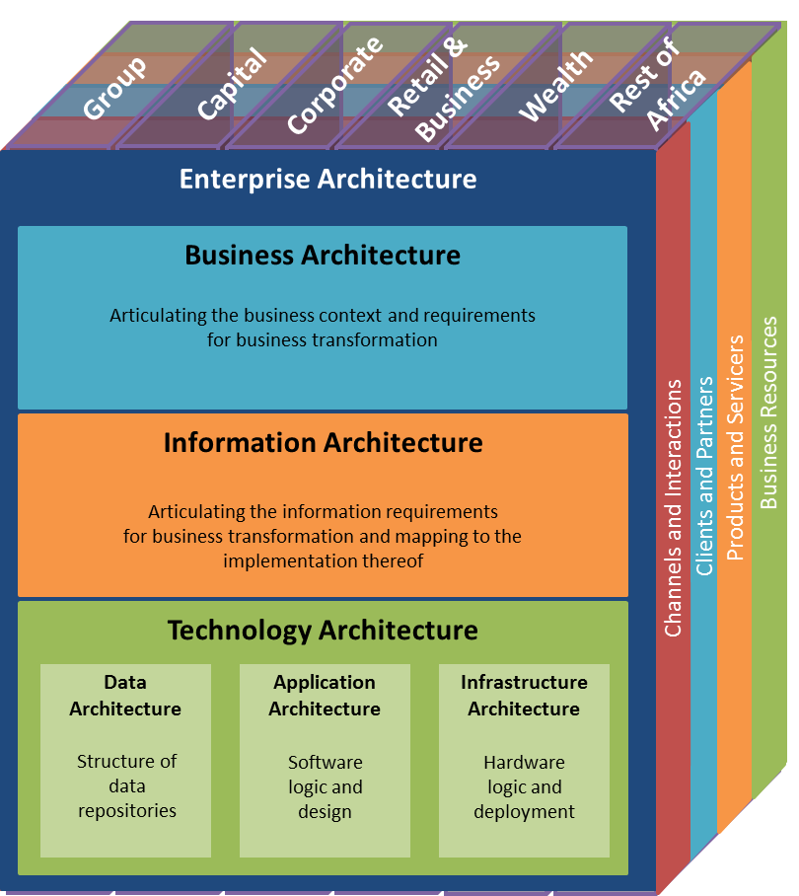
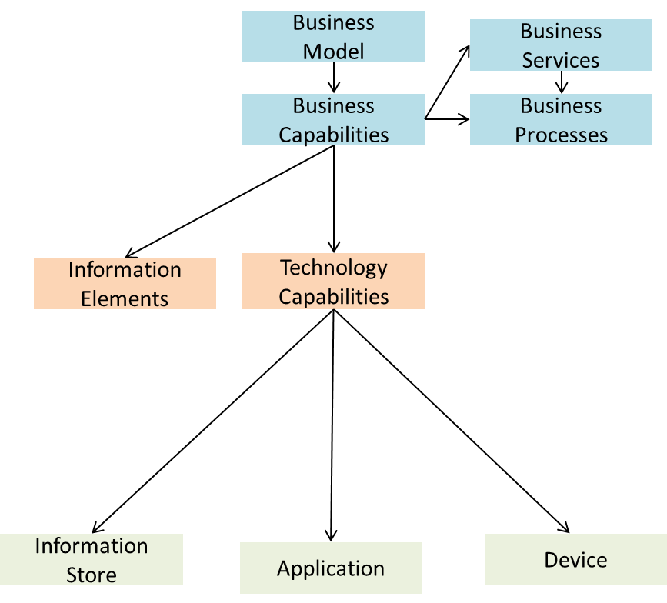
Preliminary
A.
Architecture
Vision
H.
Architecture
Change
Management
B.
Business
Architecture
G.
Implementation
Governance
Requirements
Management
C.
Information
Systems
Architectures
F.
Migration
Planning
D.
Technology
Architecture
E.
Opportunities
and Solutions

Slide 13
Preliminary
Group and Cluster strategies were decomposed in detail with the clusters
Derived business demand and value delivery in three year plans
High priority Business Capabilities required to fulfil on Group strategic aspirations were identified based on strategy decomposition
A.
Architecture
Vision
H.
Architecture
Change
Management
B.
Business
Architecture
G.
Implementation
Governance
Requirements
Management
C.
Information
Systems
Architectures
F.
Migration
Planning
D.
Technology
Architecture
E.
Opportunities
and Solutions

Slide 14
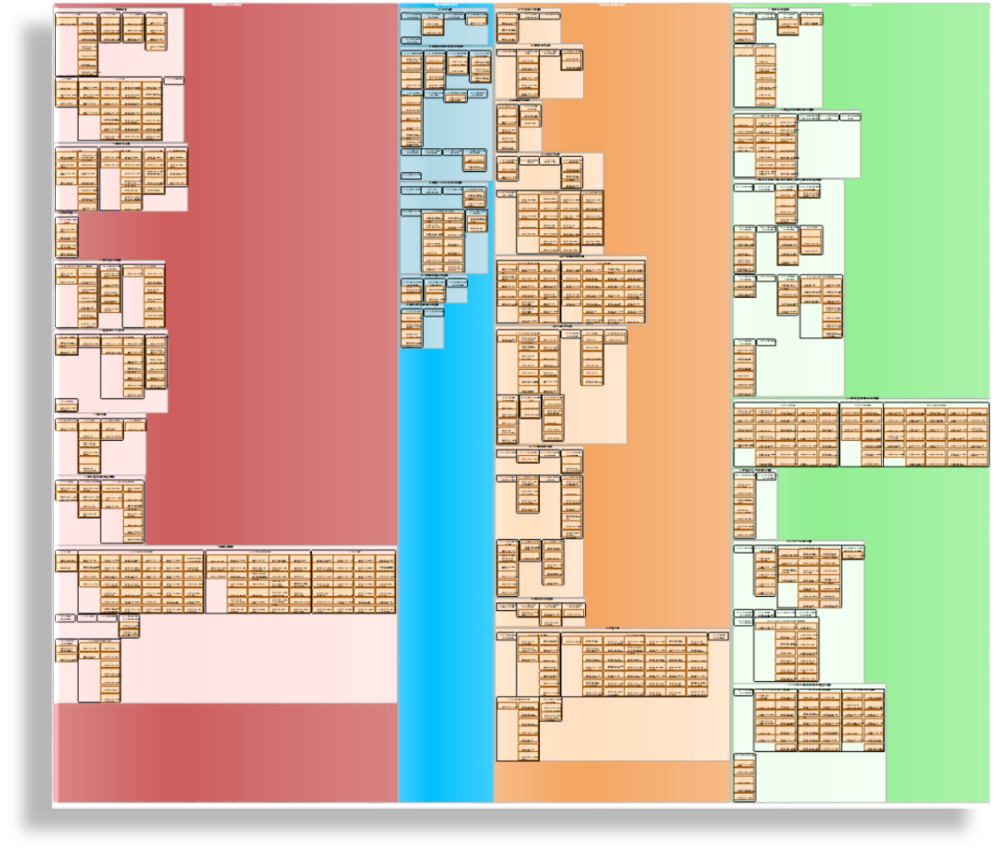
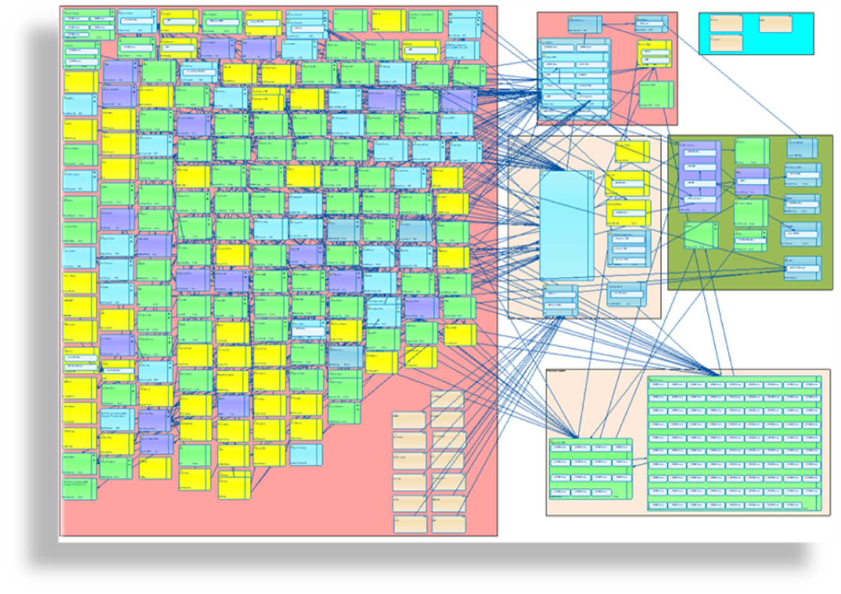
Preliminary
A.
Architecture
Vision
H.
Architecture
Change
Management
B.
Business
Architecture
G.
Implementation
Governance
Requirements
Management
C.
Information
Systems
Architectures
F.
Migration
Planning
D.
Technology
Architecture
E.
Opportunities
and Solutions

Slide 15
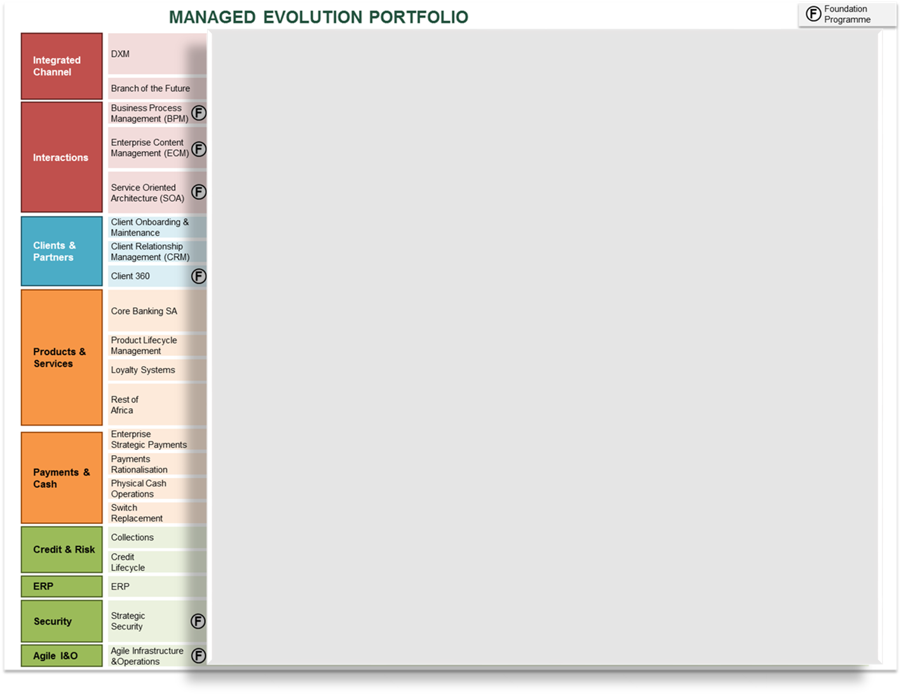
Preliminary
A.
Architecture
Vision
H.
Architecture
Change
Management
B.
Business
Architecture
G.
Implementation
Governance
Requirements
Management
C.
Information
Systems
Architectures
F.
Migration
Planning
D.
Technology
Architecture
E.
Opportunities
and Solutions

Slide 16
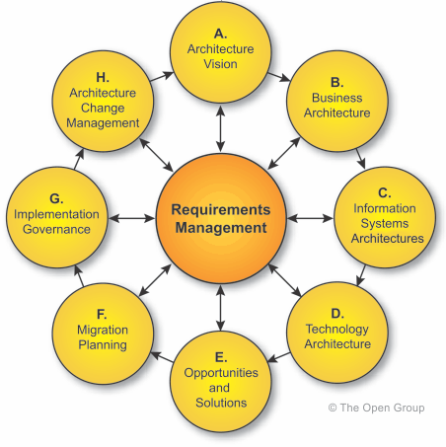
Enterprise Architecture Context
Release Context
Preliminary
Solution Architecture
(according to SDLC)
Concept Evaluation
A.
Architecture
Vision
Managed Evolution Roadmap
H.
Architecture
Change
Management
B.
Business
Architecture
High Level Design
Detail Design, BTF
G.
Implementation
Governance
Requirements
Management
C.
Information
Systems
Architectures
Release Blueprint
F.
Migration
Planning
D.
Technology
Architecture
E.
Opportunities
and Solutions

Slide 17
Yesterday
Thinking framework
Standardise architecture language
Community building
Across industries
Various levels of the organisation

Slide 18

Today

Slide 19
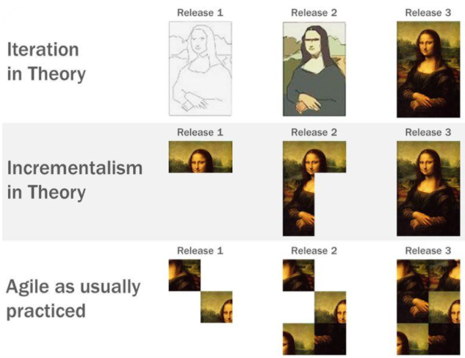
Is TOGAF relevant in an Agile world?
The TOGAF® Standard, Version 9.2
© 2005-2018 The Open Group, All Rights Reserved

Slide 20
Cloud
Generalisation for future re-use
Not lift and shift, but refactor, replatform, replace, …
Business and technology management
Architecture drives migration roadmaps and deployment models
The TOGAF® Standard, Version 9.2
© 2005-2018 The Open Group, All Rights Reserved

Slide 21
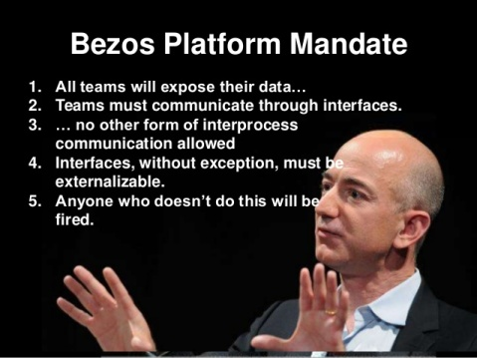
API Economy
The National Institute of Standards and Technology (NIST), 1988 Information Management Directions: The Integration Challenge. Special Publication 500-167
http://www.slideshare.net/InfoEcon/platform-strategy-ibm-72511

Slide 22
Today
TOGAF supports agility
TOGAF is iterative
Just another style of architecture

Slide 23

Tomorrow

Slide 24
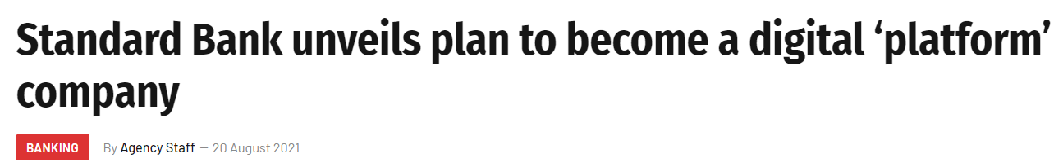
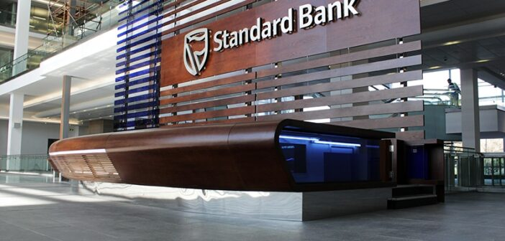
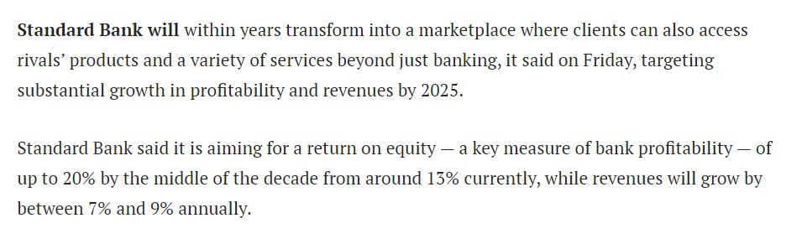

Future Strategy

Slide 25
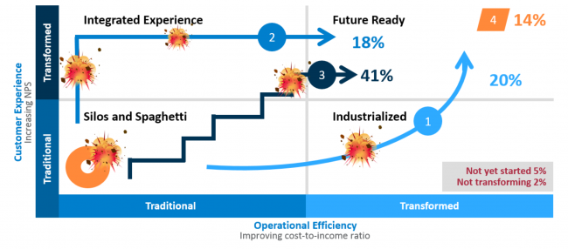
Becoming Future Ready
Future Ready? Pick your pathway for digital business transformation, MIT CISR, P Weill & S Woerner, Sep 2017

Slide 26
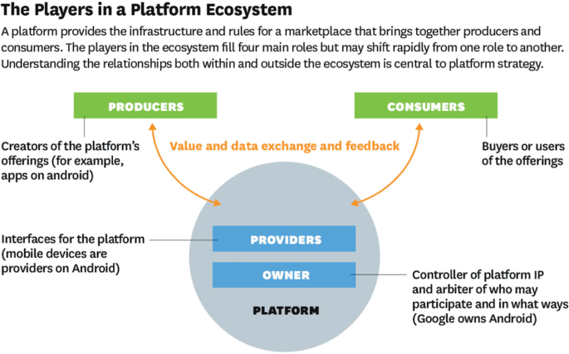
Platform Ecosystem
Parker, G., & Van Alstyne, M. (2018). Innovation, openness, and platform control. Management Science, 64(7), 3015–3032.

Slide 27
Architecture Response

Slide 28
Tomorrow
Architecture is relevant
Understand complexity
Manage change

